Slide 1

Online Medical
Store
Under Guidance of:
Mrs.Pooja Mehta
Submitted By:
1.
2.
3.
4.
5.
6.
7.

Slide 2

INTRODUCTION
The "Online Medical Store" has been developed to override the problems prevailing in the practicing manual system. This software is supported to eliminate and, in some cases, reduce the hardships faced by this existing system. Moreover, this system is designed for the particular need of the company to carry out operations in a smooth and effective manner. Our website is designed to be a one-stop shop for all of your healthcare needs. We carry a wide variety of products, including prescription and over-the-counter medications, medical supplies, and health and wellness products. We also offer a variety of services, such as online consultations with doctors, prescription delivery, and health coaching.
We believe that everyone deserves access to quality healthcare, regardless of their location or financial situation. That's why we've made our website affordable and convenient.

Slide 3

PROJECT OBJECTIVE
The main objective of the Project on Online Medical Store is to manage the details of Medicine Item, Category, Customer, Order, Confirm Order. It manages all the information about Medicine Item, Payment, Confirm Order, Medicine Item. The project is totally built at administrative end and thus only the administrator is guaranteed the access. The purpose of the project is to build an application program to reduce the manual work for managing the Medicine Item, Category, Payment, Customer. It tracks all the details about the Customer, Order, Confirm Order.

Slide 4
TECHNOLOGIES USED
Spring Boot
MySQL
Postman
Angular

Slide 5
Website: The website will be the main interface for customers to interact with the system. It will allow users to browse and purchase products and access other services.
Database: The database will store all of the information about the products and services offered by the system. This includes product descriptions, pricing, inventory levels
Order Management System: The order management system will handle the process of processing and fulfilling customer orders. This includes receiving orders, verifying payment, picking and packing products, and shipping orders to customers.
Customer Support System: The customer support system will provide support to customers who have questions or problems with the system. This includes providing information about products and services, troubleshooting problems, and resolving complaints.
PROPOSED SYSTEM

Slide 6
REQUIRED SPECIFICATIONS
Hardware Configuration | Software Configuration
Operating System : Windows 10 and above | Software IDE: Eclipse, Postman, MySQL, VS Code.
Hard Disk: 500 GB | Language: JAVA, Type Script, HTML, CSS
RAM: 8 GB | Front End: Angular, Boot Strap
 | Back End: Spring Boot, MySQL.

Slide 7
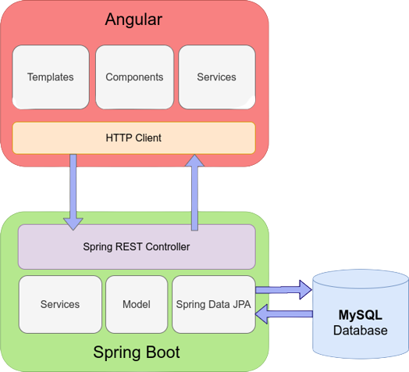
CONNECTION TO DATABASE FRONT END TO BACK END

Slide 8
MODULES
The system contains 5 Modules
ADMIN - Registration and Login.
CUSTOMER- Signup and Login.
MEDICINE LIST - Add/Edit Medicine items by Admin.
CART - Customer can add Medicine from menu list
ORDER - It shows items which present in cart and order status.
PAYMENT – Customer has to pay for completion of order.

Slide 9
SPRING ANNOTATIONS
@Controller :The @Controller annotation indicates that a particular class serves the role of a controller. Spring Controller annotation is typically used in combination with annotated handler methods based on the @RequestMapping annotation.
@Autowired: The @Autowired annotation provides more fine-grained control over where and how autowiring should be accomplished.
@RequestMapping : The @RequestMapping is one of the most common annotation used in Spring Web applications. This annotation maps HTTP requests to handler methods of MVC and REST controllers.
@Entity: The @Entity annotation specifies that the class is an entity and is mapped to a database table.

Slide 10
SPRING ANNOTATIONS
@Table: The @Table annotation is used to create a table in database.
@JoinColumn: The @JoinColumn is used to specify a column for joining an entity association or element collection.
@PutMapping : The @PutMapping is used for update the records.
@PostMapping: The @PostMapping is used to create a resource Mapping.
@GetMapping: The @GetMapping is used to read all the inserted records.
@DeleteMapping : The @DeleteMapping is used to delete the records.
@PathVariable: The @Path Variable annotation is used to extract the value from the URL.
@RequestParam: The @RequestParam annotation is used to read the form data and bind it automatically to the parameter present in the provided method.

Slide 11
SPRING ANNOTATIONS
@Request Body: The @RequestBody annotation is applicable to handler methods of spring controller. spring should deserialize a request body into an object.
@OneToOne Mapping: The @OneToOne JPA annotation is used to map the source entity with the target entity, Hibernate maps the tables in your database to the Entity classes in your application.
@OneToMany Mapping: The @OneTo-Many relationship between table A and table B indicates that one row in a table A link to many rows in table B.but one row in table B links to only one row in table A.
@ManyToOne Mapping: The @Many-to-One mapping means that many instances of this entity are mapped to one instance of another entity.

Slide 12
SPRING ANNOTATIONS
@ExceptionHandler:The @ExceptionHandler is an annotation used to handle the specific exceptions and sending the custom responses to the client.
@ControllerAdvice: A controller advice allows you to use exactly the same exception handling techniques but apply them across the whole application, not just to an individual controller. You can think of them as an annotation driven interceptor.

Slide 13
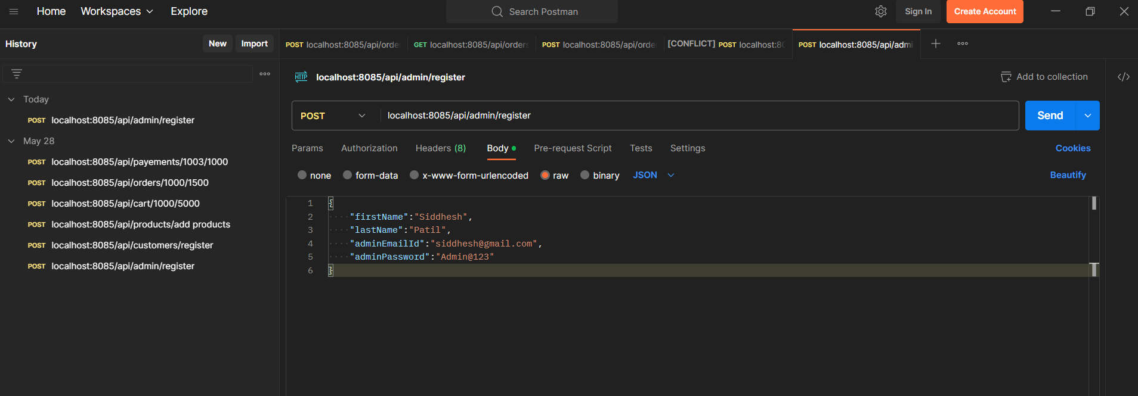
ADMIN REGISTRATION FROM POSTMAN

Slide 14
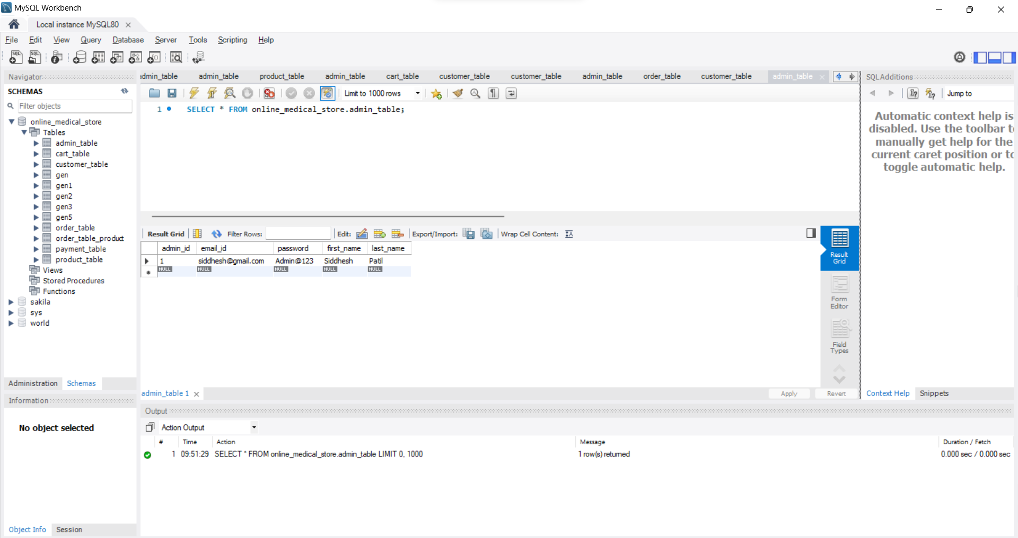
ADMIN TABLE

Slide 15
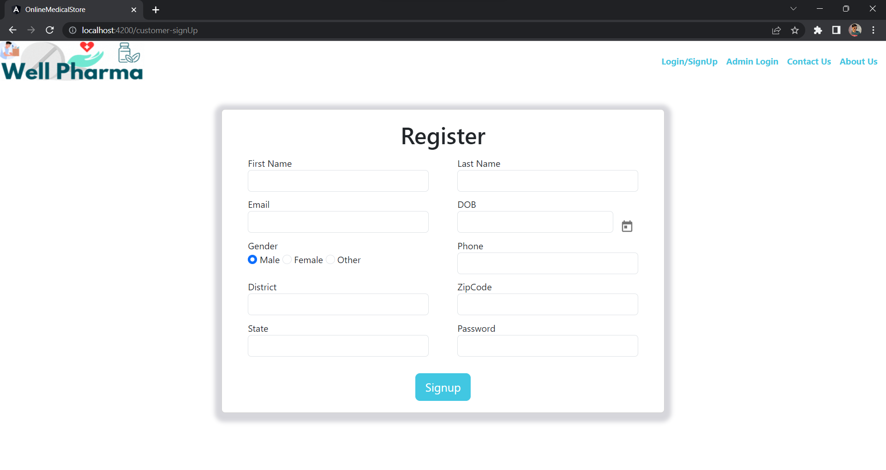
CUSTOMER REGISTRATION

Slide 16
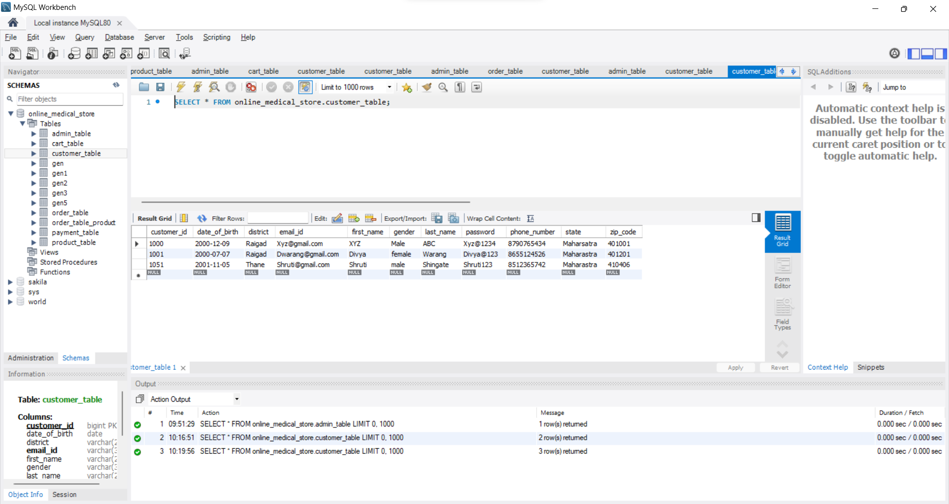
CUSTOMER TABLE

Slide 17
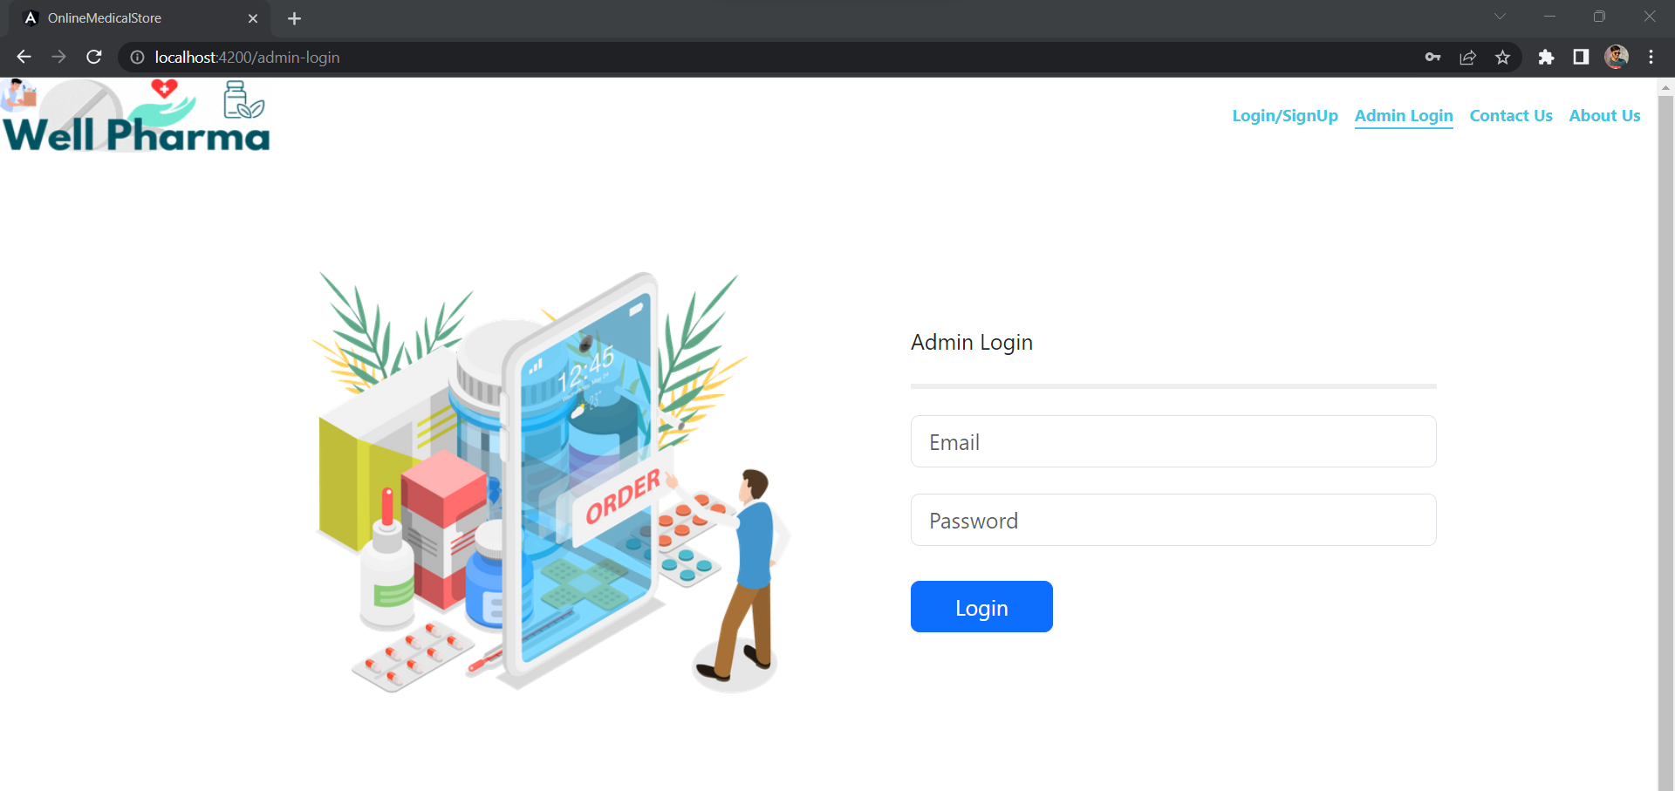
ADMIN LOGIN

Slide 18
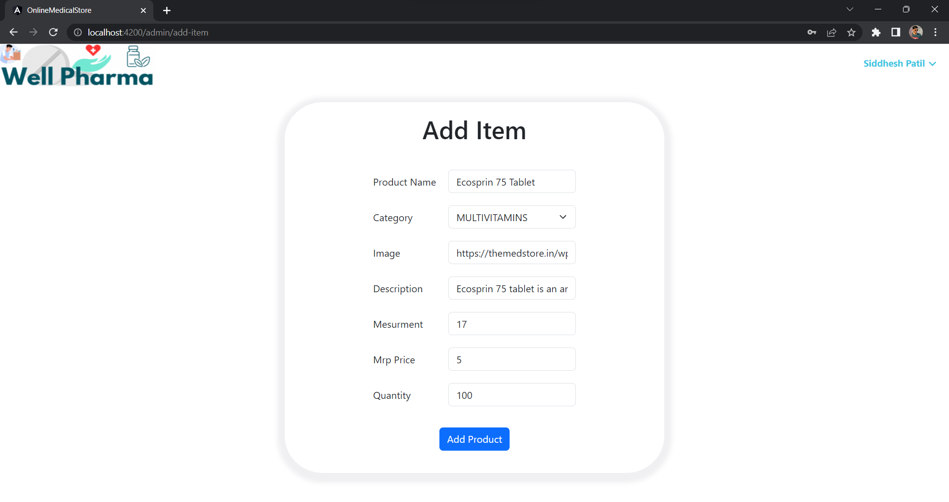
ADD MEDICINE FROM ADMIN

Slide 19
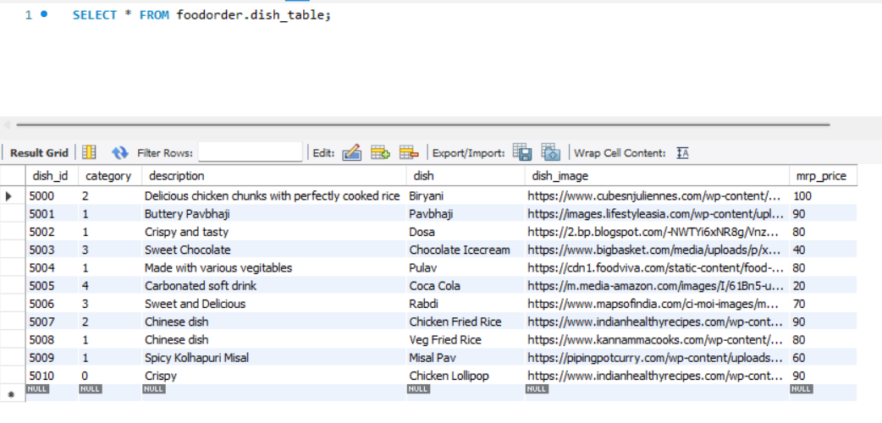
MEDICINE TABLE

Slide 20
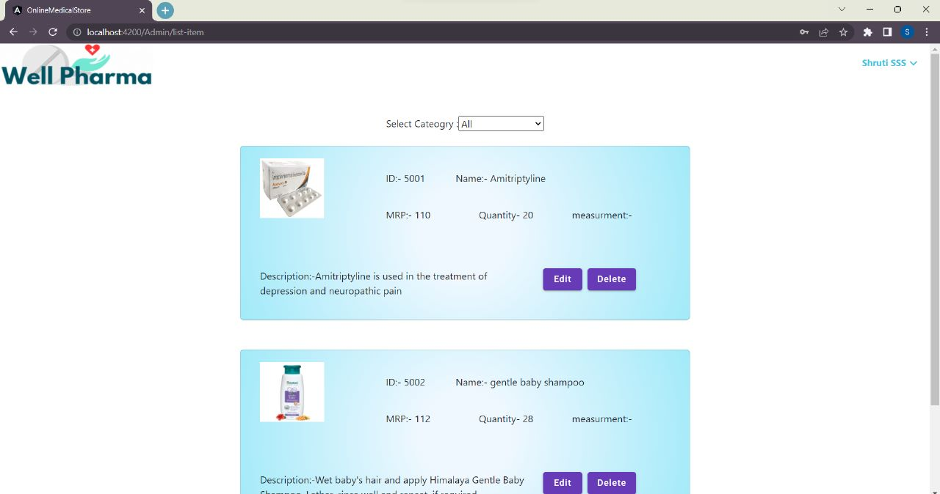
MEDICINE LIST

Slide 21
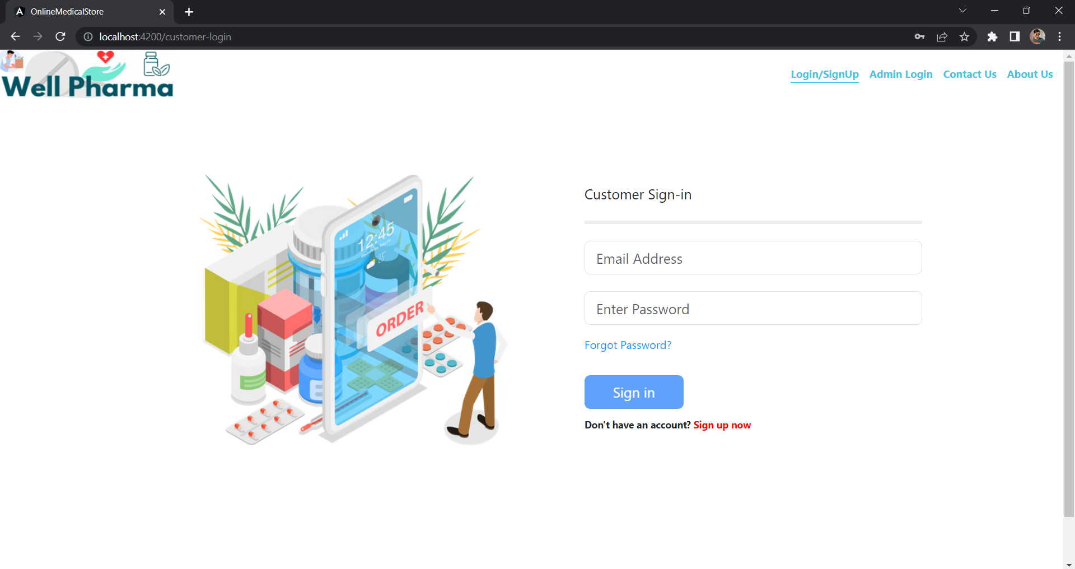
CUSTOMER LOGIN

Slide 22
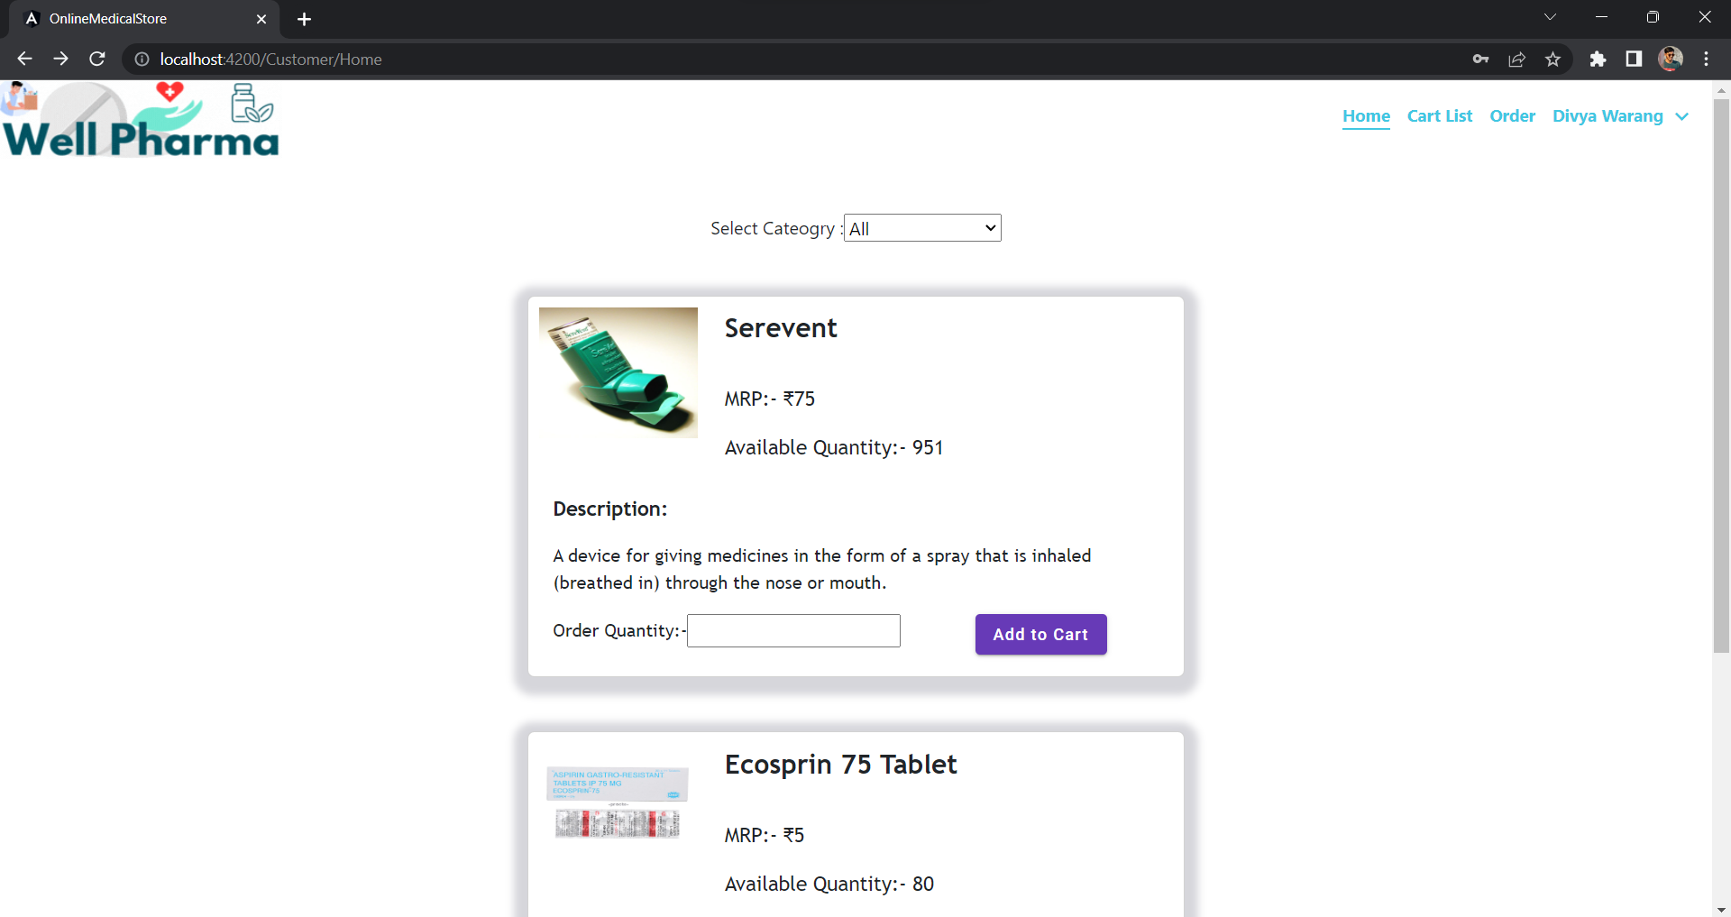
CUSTOMER HOME PAGE

Slide 23
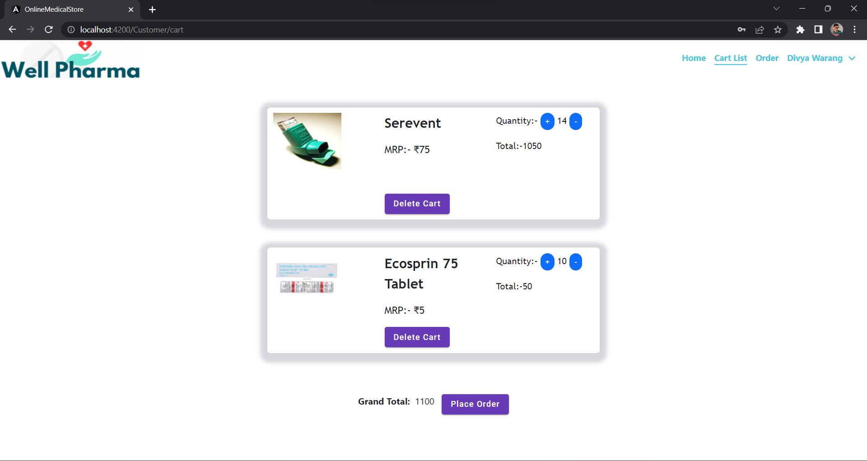
CUSTOMER CART

Slide 24
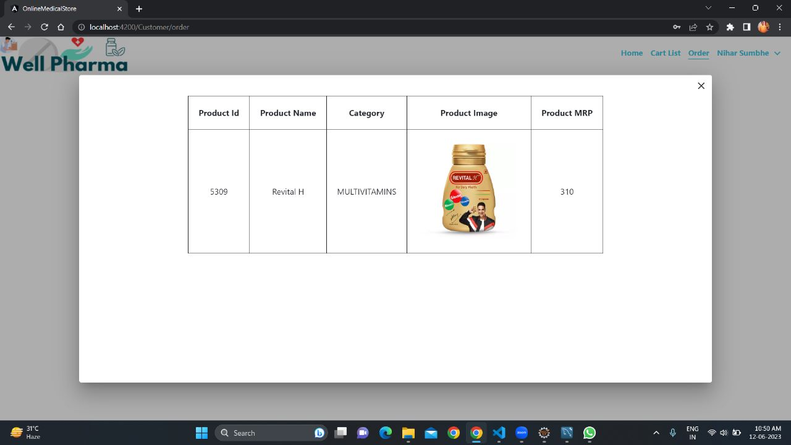
CUSTOMER ORDER

Slide 25
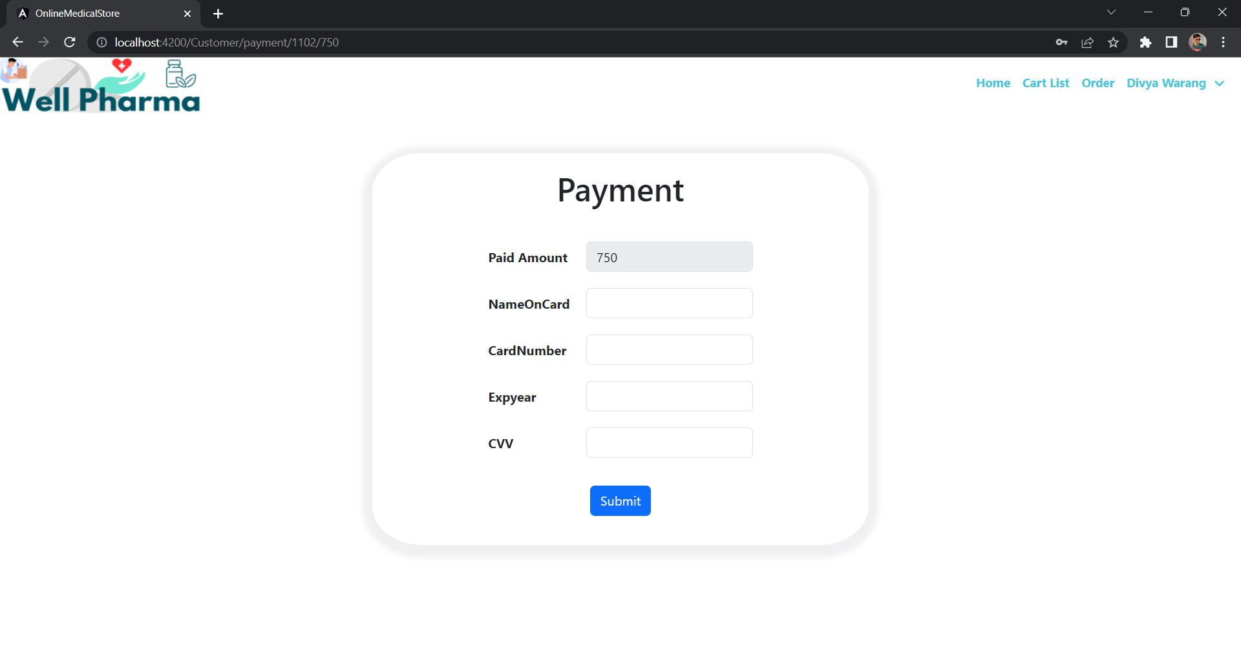
CUSTOMER PAYMENT

Slide 26

ADVANTAGES
Convenience: Online medical store websites allow you to purchase healthcare products and services from anywhere with an internet connection. This can be especially convenient if you have a busy schedule or live in a rural area where access to healthcare is limited.
Affordability: Online medical store websites often offer lower prices than traditional brick-and-mortar stores. This is because they have lower overhead costs, such as rent and staffing.
Wide selection: Online medical store websites offer a wider selection of products and services than traditional brick-and-mortar stores. This is because they are not limited by space constraints.
24/7 availability: Online medical store websites are available 24 hours a day, 7 days a week. This means that you can purchase healthcare products and services whenever you need them, even if it is outside of normal business hours.
Privacy: Online medical store websites offer a high level of privacy. Your personal information is not shared with third-party companies without your consent.

Slide 27

CONCLUSION
Online Medical Store is done to help and solve one of the important problems of customer. Because Large number of customer can use the internet and phone. Various issues will be solved by these system .Thus, implementation of Online Medical Store is done to help and solve one of the important problems of customer. It helps customer in making order easily and gives information needed in making order to customer place.

Slide 28
THANK YOU

